Slide 1
Make the Leap
From Dev to Production with openSUSE Leap
James Mason
bear454@opensuse.org
Richard Brown
rbrown@opensuse.org

Slide 2
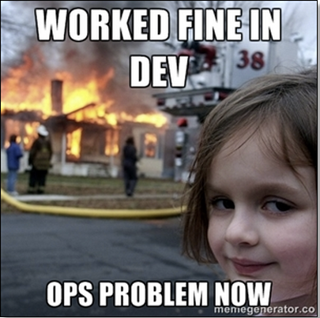

Slide 3
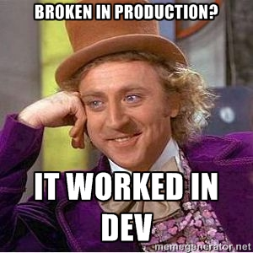

Slide 4
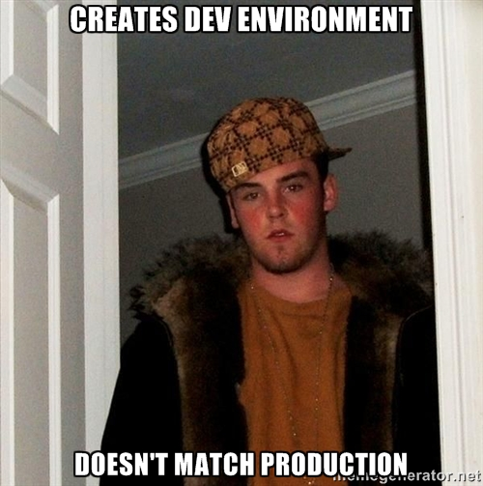

Slide 5
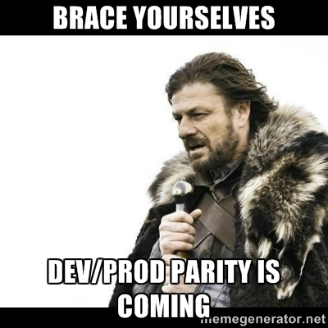

Slide 6
Why Does This Problem Exist?
Community
Distributions
Lots of Packages
Community Developed
No Guarantees
Enterprise
Distributions
Fewer Packages
Mission Critical

Slide 7
Why Does This Problem Exist?
Userspace applications in Enterprise distributions suck
If you have them, they’re probably old
You need userspace applications to do development

Slide 8
But, Containers!!
Containers are NOT the solution
Many libs in many containers – maintenance nightmare
“Dev problem”
Developers do not have the skills or the tools to take that responsibility
Impact on Certifications
Still lacking userspace applications
Possibly part of the solution, not a solution in itself

Slide 9
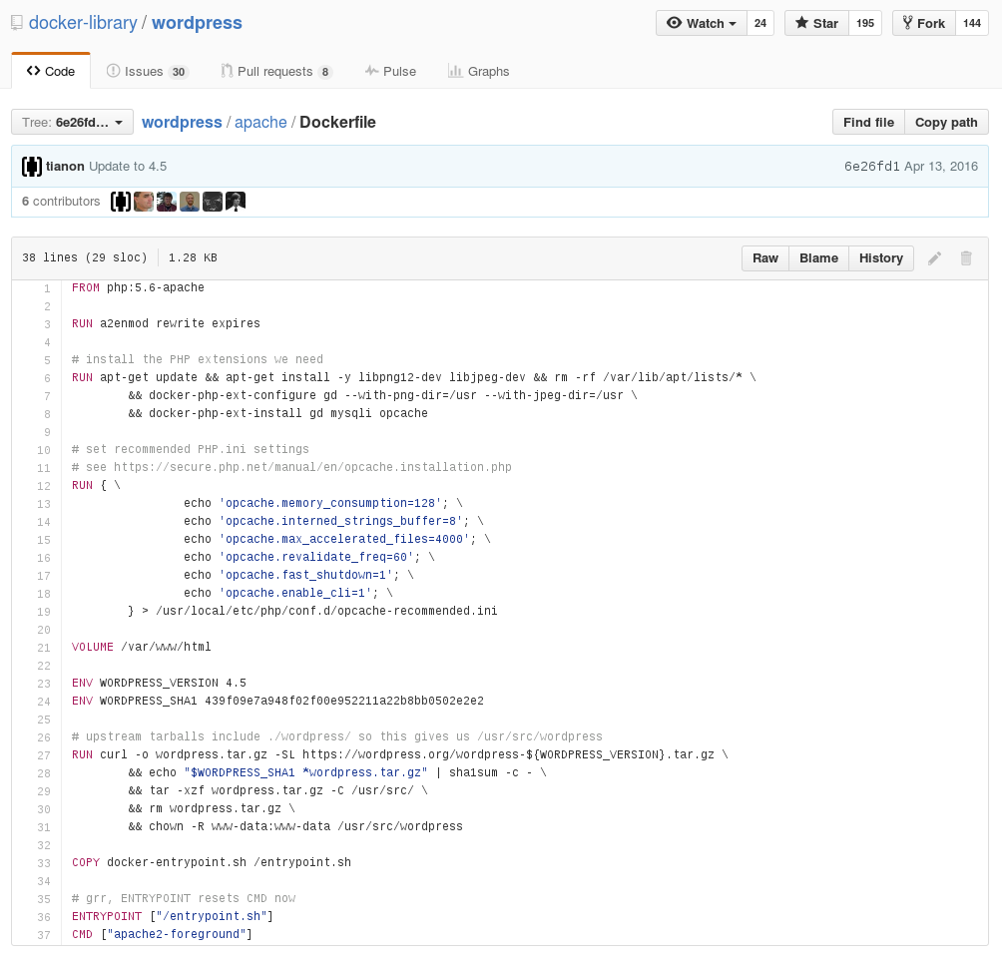

Slide 10
RUN curl -o wordpress.tar.gz
-SL https://wordpress.org/wordpress-${WORDPRESS_VERSION}.tar.gz

Slide 11
FROM php:5.6-apache

Slide 12
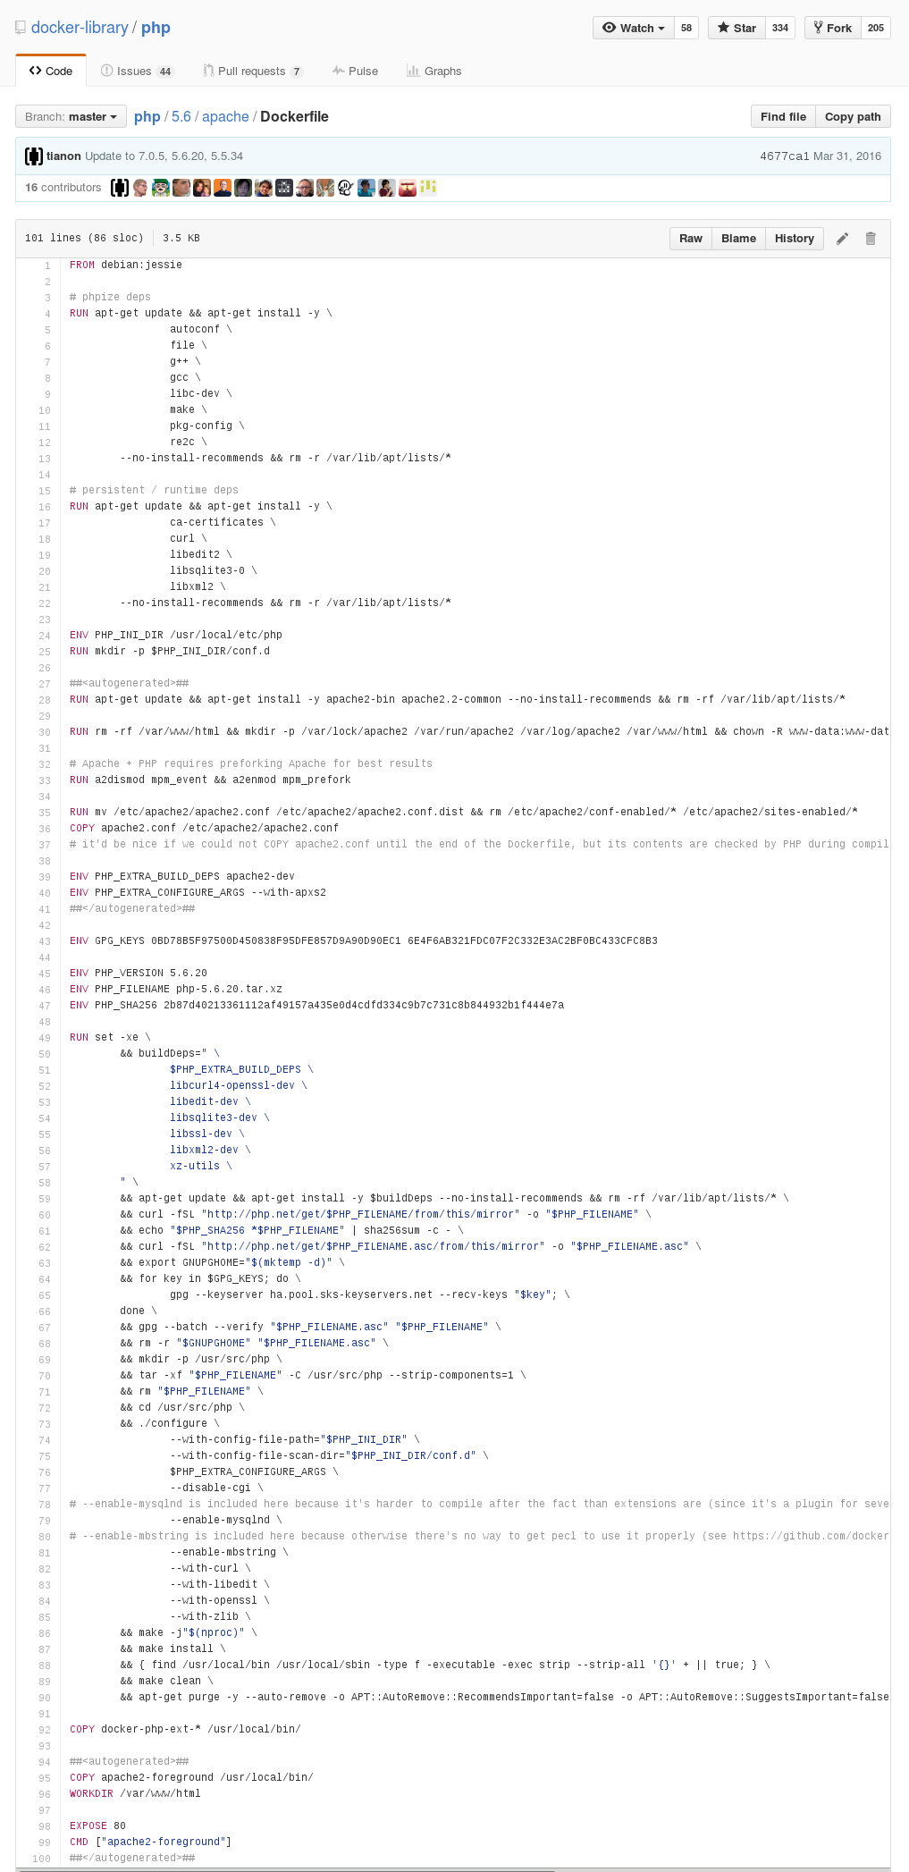

Slide 13
&& make -j"$(nproc)" \
&& make install \

Slide 14
FROM debian:jessie

Slide 15
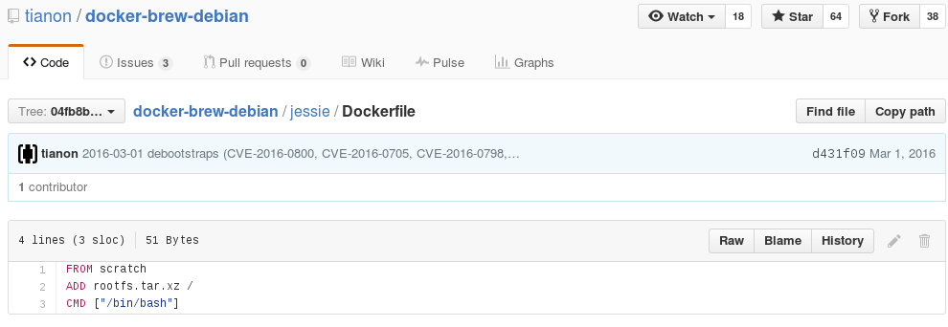

Slide 16
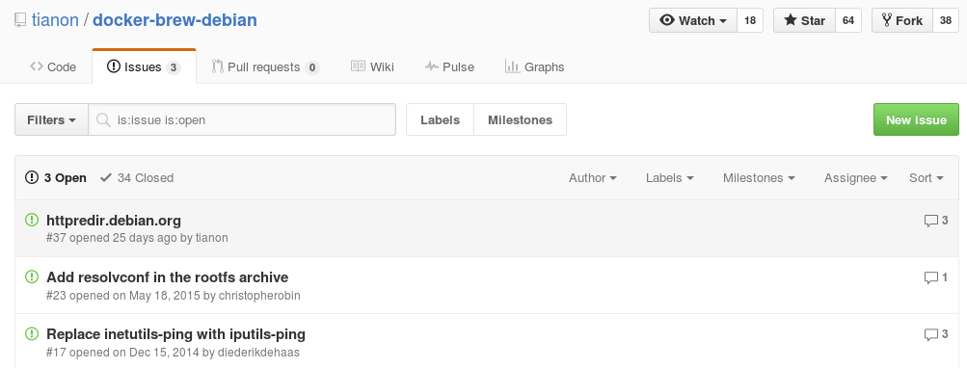

Slide 17
A Practical Lesson in Why
Distribution Packaging Matters.

Slide 18
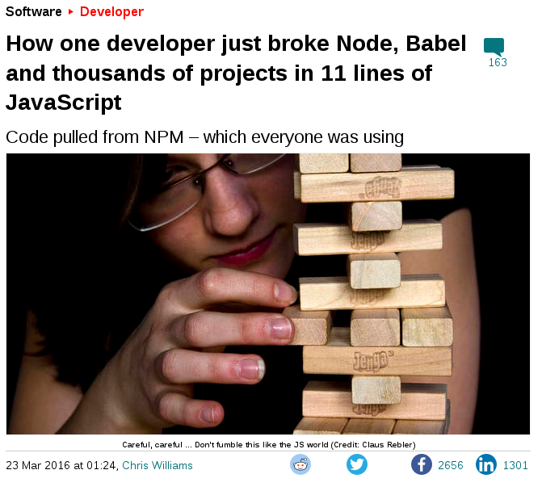

Slide 19
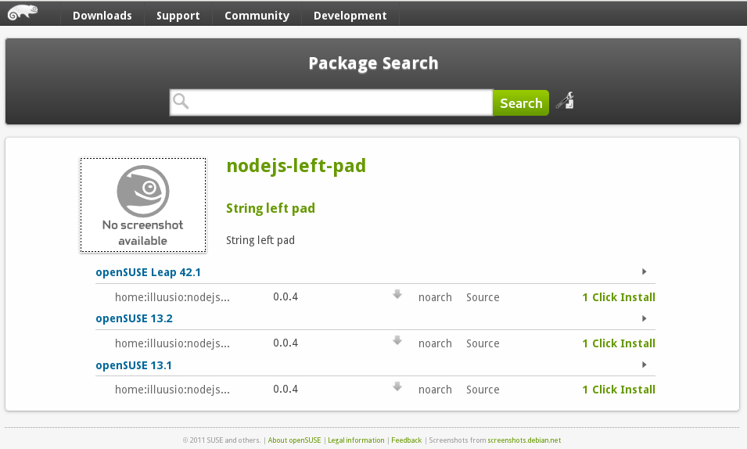

Slide 20
An Example Software Stack

Slide 21
Python
 | Python 2 | Python 3
Ubuntu 16.04 LTS | 2.7.11 | 3.5.1
Ubuntu Server 14.04 LTS | 2.7.5 | 3.4.0
Fedora 24 | 2.7.11 | 3.5.1
RHEL 7.2 | 2.7.5
openSUSE Leap 42.1 | 2.7.9 | 3.4.1
SLES 12 SP1 | 2.7.9 | 3.4.1

Slide 22
IDE?
 | gnome-builder | kdevelop
Ubuntu 16.04 LTS | 3.18 | 4.7.3
Ubuntu Server 14.04 LTS |  | 4.6.0
Fedora 24 | 3.20 | 4.90.91
RHEL 7.2
openSUSE Leap 42.1 | 3.16 | 4.7.1
SLES 12 SP1

Slide 23
Distribution lifecycles
- or -
How often do you want to rebuild everything?

Slide 24
Ubuntu LTS
“A new LTS version is released every 2 years … Starting with Ubuntu 12.04 LTS, both versions will receive 5 years support.”

Slide 25
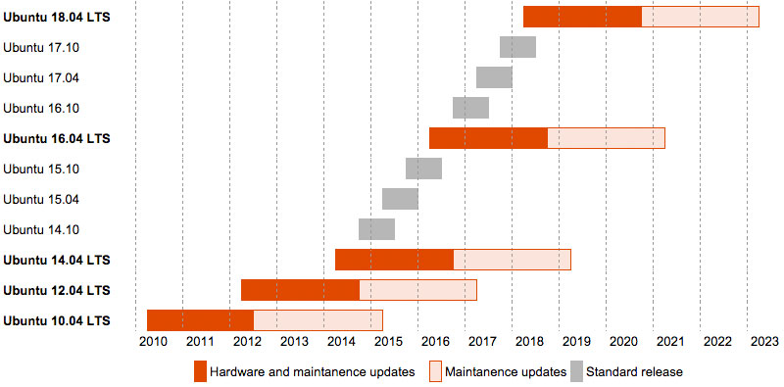
Ubuntu LTS

Slide 26
RHEL
“Red Hat Enterprise Linux versions 5, 6, and 7 each deliver 10 years of support in Production Phases 1, 2, and 3 followed by an Extended Life Phase.”

Slide 27
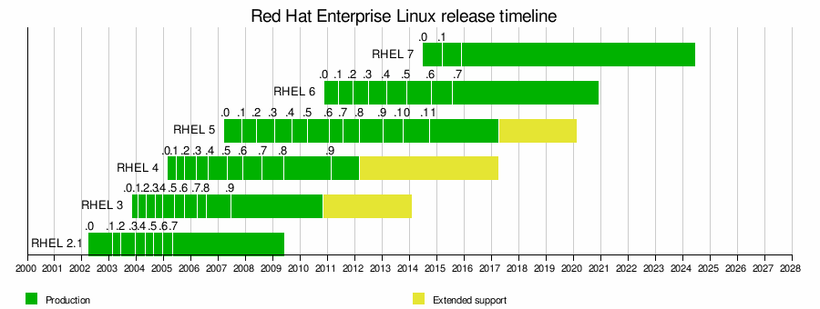
RHEL

Slide 28
SLES
“SUSE products are supported for up to thirteen years.”

Slide 29
SLES

Slide 30
Apples to Apples
 | Hardware enablement | Critical updates | Extended Support
Ubuntu LTS | 2 years | 5 year | n/a
RHEL | 4-5 years | 7 years | 10 years
SLES | 5-7 years | 10 years | 13 years

Slide 31
One small step for man
One giant Leap for developers

Slide 32
openSUSE®
Open Source Community Project sponsored by SUSE®
Founded 9th August 2005
“Promotes the use of Linux everywhere”
Produces the openSUSE distributions

Slide 33

10 years old!
CC-BY lawrencedesign @ flickr.com

Slide 34






snapper
openQA
wicked

Slide 35


Slide 36
More New Stuff
More Stable

Slide 37

More Stable

Slide 38

A 'Perfect' Regular Release?
Stable
Well Maintained
Enterprise Base System
Lifecycle of 3 years (or more)
Wide Selection of Packages
Modern, relevant Userspace for Users & Developers

Slide 39

“With our powers combined”
SUSE® Linux
Enterprise

Slide 40
Development Benefits
Offering a stable code base
SUSE® Linux
Enterprise
Improved collaboration
Adopting upstream innovation

Slide 41
The openSUSE/SUSE Family
>8000 Packages
Community Developed
Rolling Updates
Over 6000 Packages
Community Developed
SUSE® Linux Enterprise
Shared Core
Enterprise Packages
SUSE Developed
Rolling Base System
Stable Base System
Regular Updates

Slide 42
openSUSE® & SLE - Developing Together
openSUSE Tumbleweed
Leap
42.1
Leap
42.2
Leap
42.3
Core
12.1
Core
12.2
Core
12.3
SLE
12 SP1
SLE
12 SP2
SLE
12 SP3

Slide 43
openSUSE Leap 43.0
openSUSE Tumbleweed
Leap
42.2
Leap
42.3
Leap
43.0
Core
12.2
Core
12.3
Core
13
SLE
12 SP2
SLE
12 SP3
SLE
13

Slide 44
openSUSE Leap 43.0 and Beyond
openSUSE Tumbleweed
Leap
43.0
Leap
43.1
Leap
43.2
Core
13
Core
13.1
Core
13.2
SLE
13
SLE
13 SP1
SLE
13 SP2

Slide 45
openSUSE Leap
A 'Perfect' Regular Release?
Stable
Well Maintained
Enterprise Base System
Lifecycle of 3 years (or more)
Wide Selection of Packages
Modern Userspace for Users & Developers
✓
✓
✓
✓
✓
✓

Slide 46
Questions

Slide 48
Join the conversation,
contribute & have a lot of fun!
www.opensuse.org

